Slide 1
I400 – Application Development in Java
Lecture 10

Slide 2
Today
CH 16 – Graphical User Interfaces
Installing JavaFX and SceneBuilder
Creating JavaFX Programs and FXML Documents
SceneBuilder
GUI Components: Button, Label, etc…
Layouts (actually Ch 14)

Slide 3
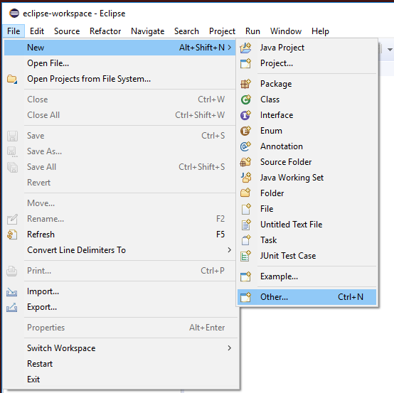
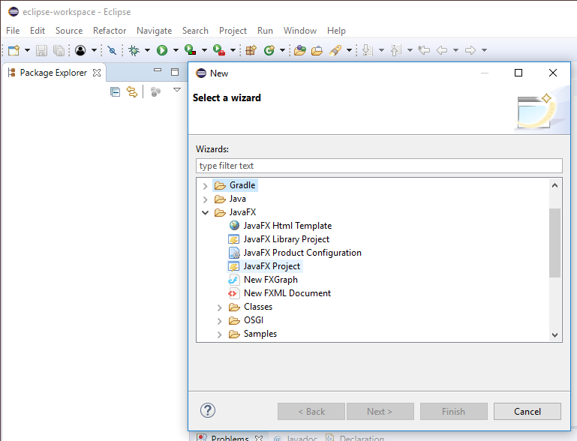
Issue
Some of the lab machines have the software we need, some don’t!
If you see these options, your machine has it.

Slide 4
Installing JavaFX
Open Eclipse
Click on Help in the toolbar
Select Install New Software

Slide 5
Installing JavaFX
Select "Oxygen - http://download.eclipse.org/releases/oxygen" from the dropdown

Slide 6
Installing JavaFX
Type fx in the type filter text text box
You will get an option to select e(fx)clipse in the big selection box.
Select Finish

Slide 7
Installing JavaFX
It might ask you to accept the terms and conditions for using e(fx)clipse which you can accept, this will install the required dependencies for JavaFX
Eclipse will restart once JavaFX is installed.

Slide 8
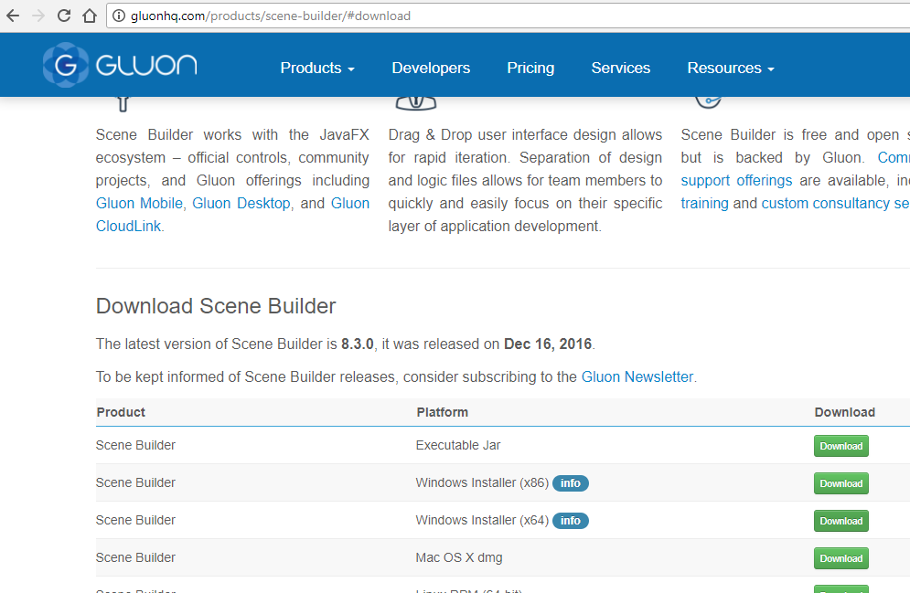
Install Scene Builder
Go to: http://gluonhq.com/products/scene-builder/#download
Find the x64 file (for Windows) or the appropriate Mac or Linux file.
Click on the Download button, then install the file.

Slide 9
Please Note!
Installing JavaFX and SceneBuilder will take you a few minutes.
If you are working on lab machines, do this at the beginning of each lecture.
If you are working on your own machine, you only have to do this once.

Slide 10
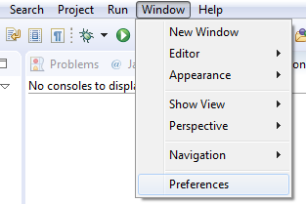
Set Path for Scene Builder
In Eclipse, select Window->Preferences

Slide 11
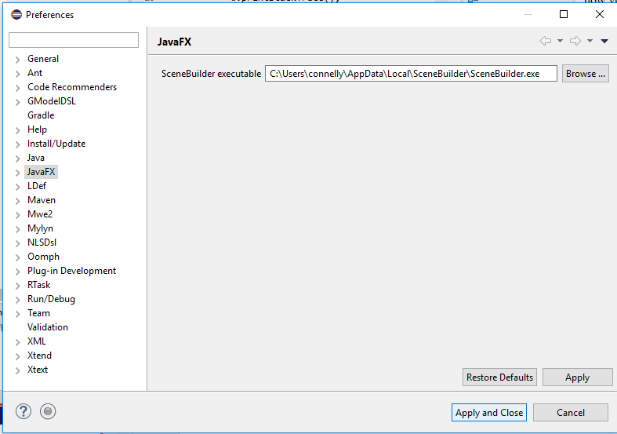
Set Path for Scene Builder
Select JavaFX, then set the SceneBuilder path
C:\Users\<YOUR USER>\AppData\Local\SceneBuilder\SceneBuilder.exe
User your username!

Slide 12
Create a New Java FXML Project

Slide 13
Create a New Java FXML Project

Slide 14
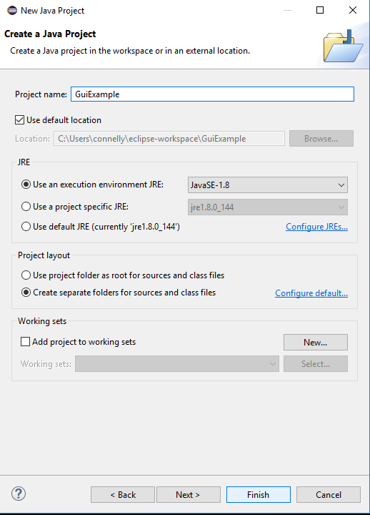
Name Your Project

Slide 15
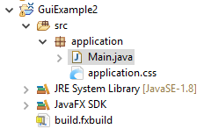
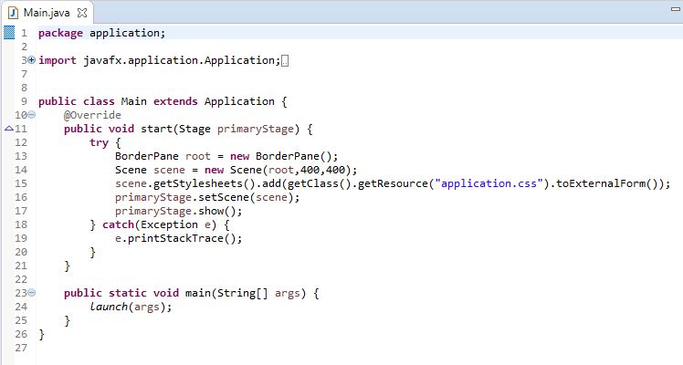
Main.java of FXML project
How to find Main.java:
Code template:
Extends Application
Must override start()

Slide 16
Main.java of FXML project
Code template:
Initializes some objects (we will learn more later) and calls .show() to display them
Main calls Launch()

Slide 17
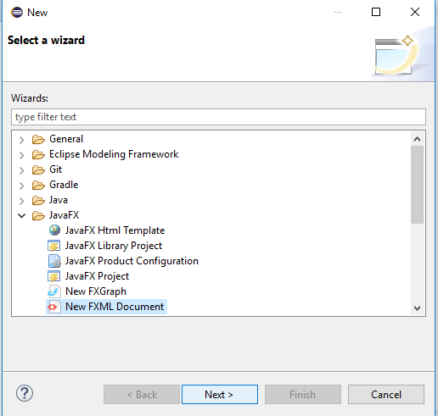
Create a New FXML Document
For each window in your app, you need an FXML document
Right-click on your project in the package explorer
Add a New -> Other
Select New FXML Document

Slide 18
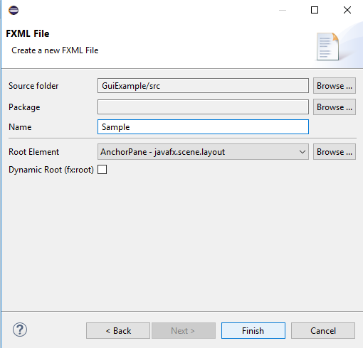
Give the FXML Document a Name
Each window will need a different name, so for your projects, be smart about it!

Slide 19
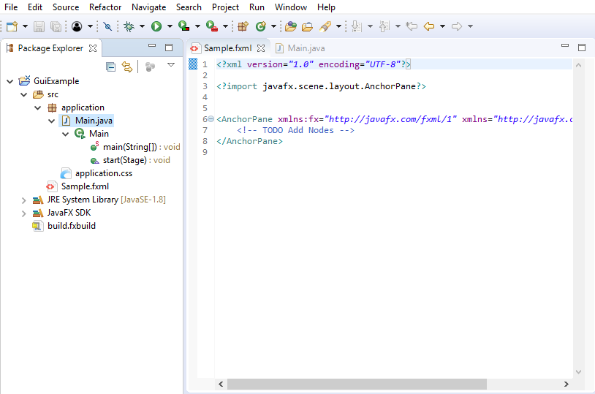
Look at Sample.fxml
Layout is stored in a .fxml file
FXML is an XML-based interface markup language created by Oracle for JavaFX
It looks very similar to XML

Slide 20
Look at Sample.fxml
At some point, you may want to fine tune a layout directly in FXML, so you’ll want to become familiar with it
But for now, we’ll use Scene Builder…

Slide 21
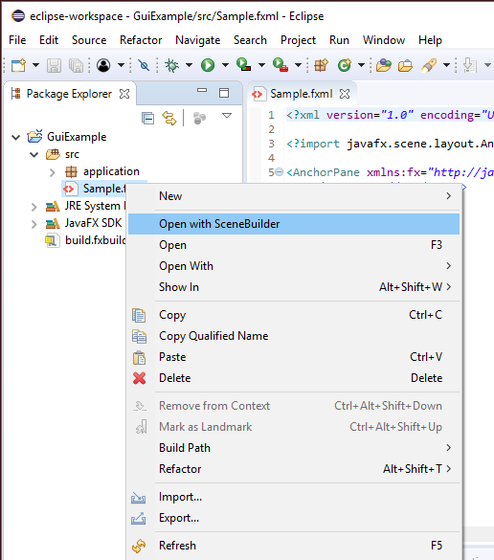
Open Sample.fxml with SceneBuilder
In the Package Explorer in Eclipse, Right-click on Sample.fxml
Click Open with SceneBuilder

Slide 22
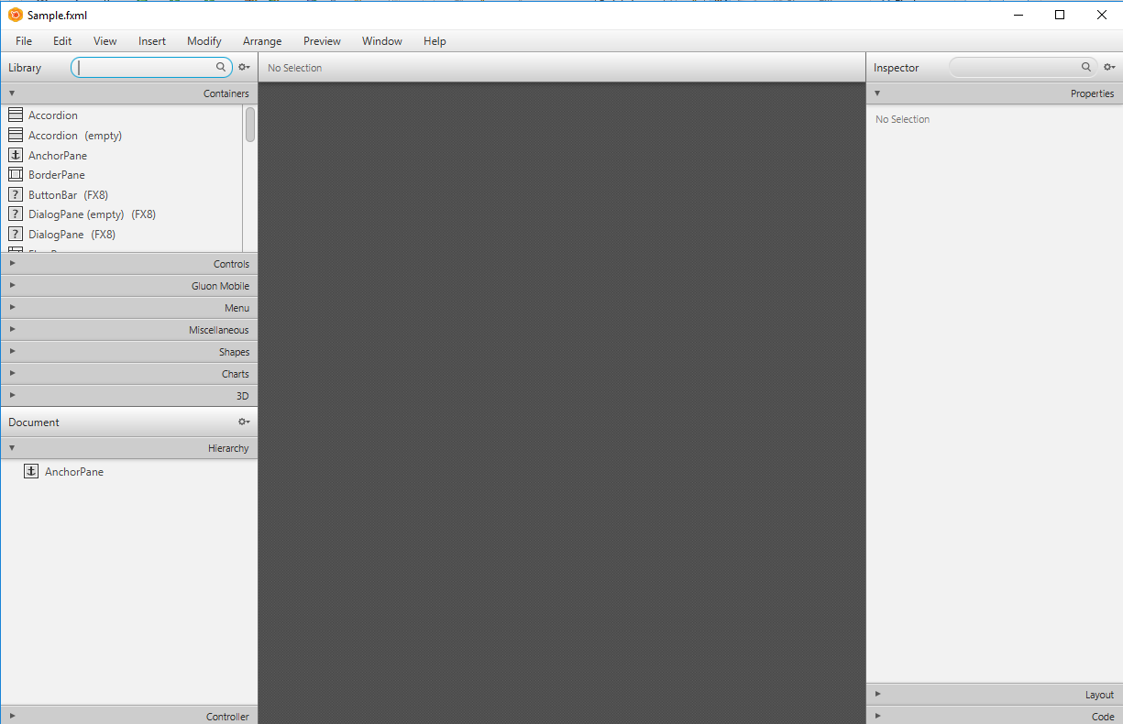
Scene Builder
Library
Possible
GUI
Components
To Add
Properties
of Selected
Component
(none selected
right now)
Document
Current
Components
Design Area
(Empty Right Now)

Slide 23
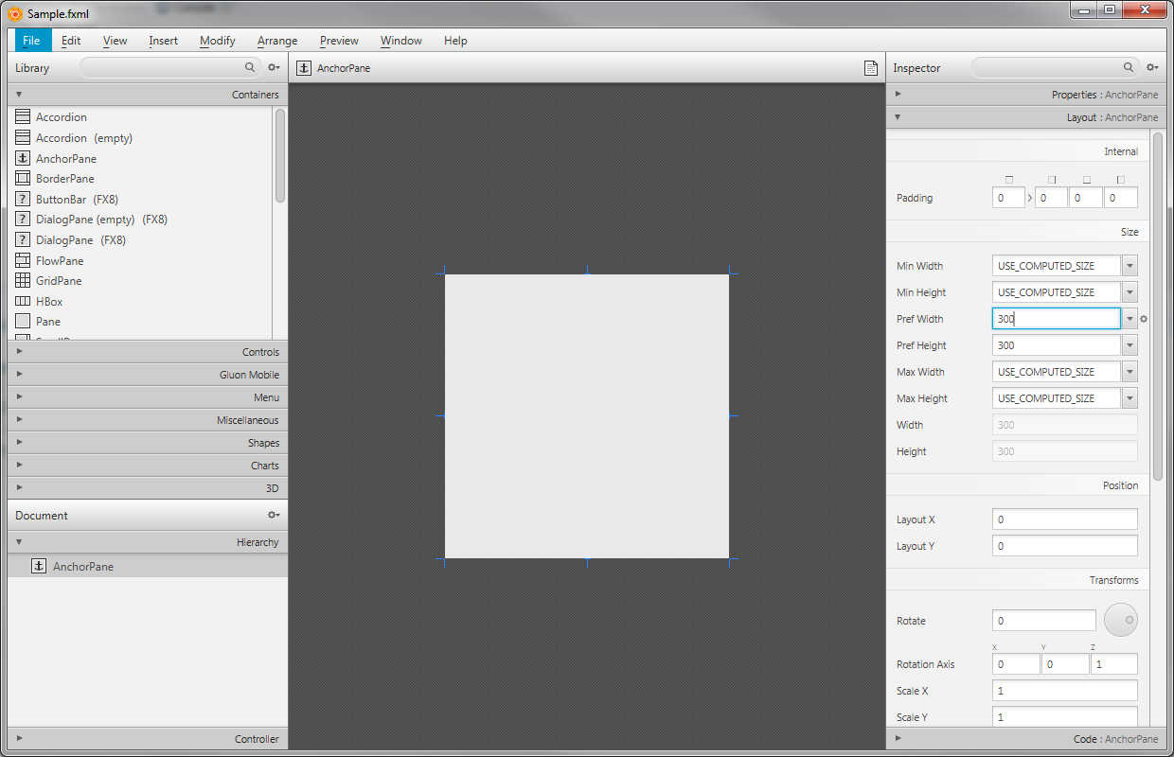
Size of Anchor Pane
Select the AnchorPane in the bottom left.
In the top right, select the Layout tab, then change the window to be 300 x 300.

Slide 24
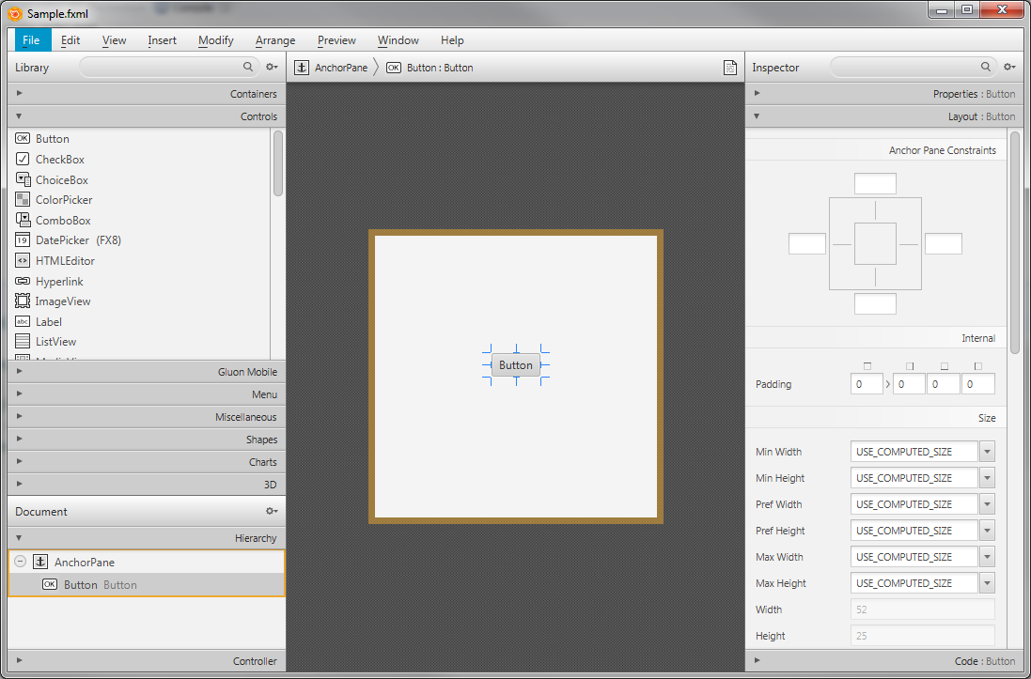
Add a Button
Drag a Button (from Controls Library) to the middle design area or into AnchorPane in Document area

Slide 25
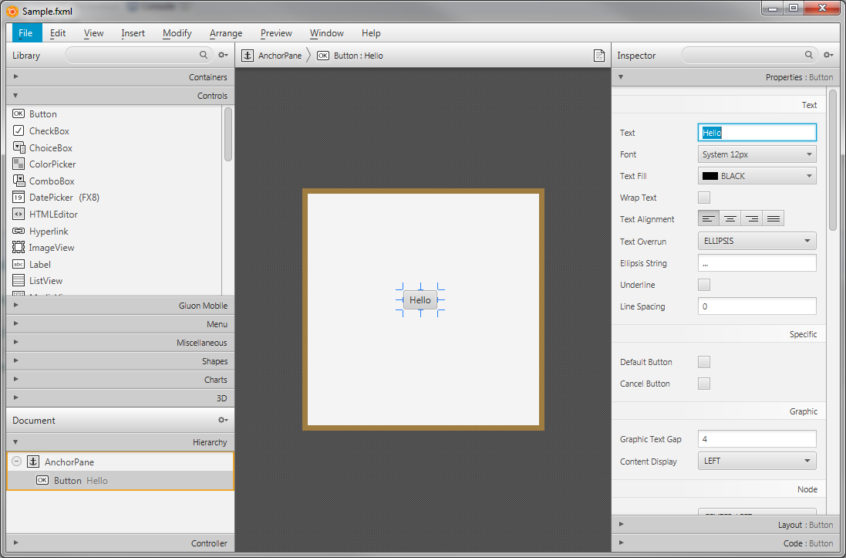
Add a Button
Make sure the button is highlighted/ selected
On the right, select the Properties tab.
Change Text to say “Hello!”

Slide 26
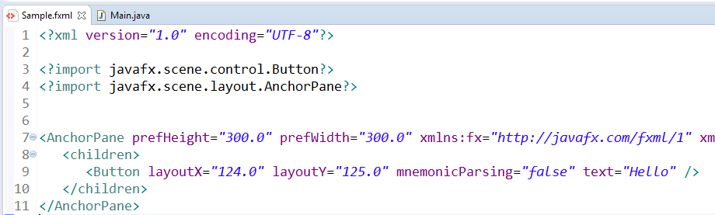
Back to .fxml in Eclipse…
When you Save in Scene Builder, it changes the .fxml code in Eclipse!

Slide 27
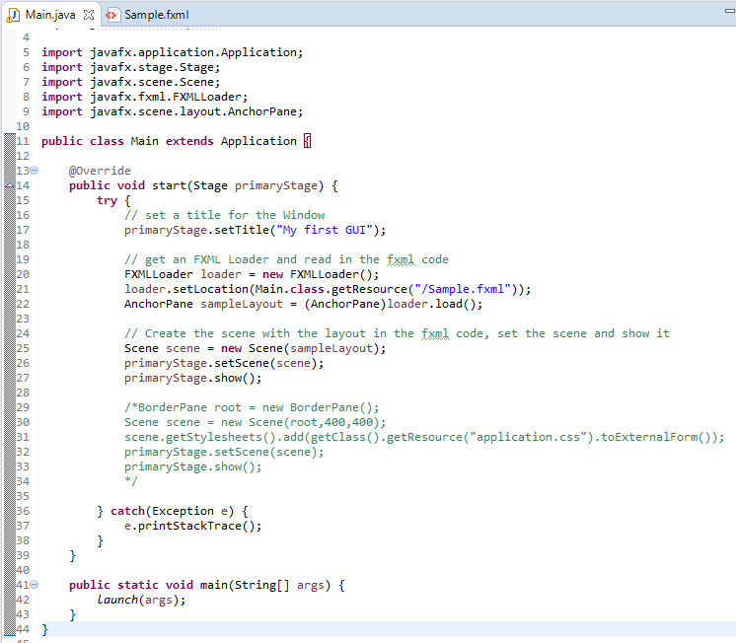
Load fxml into Java
Import FXMLLoader and AnchorPane
Set the title of the window
Create a loader and read FMXL file
Set the scene and show it
Original code that we comment out (you can remove it)
1
2
3
4
5

Slide 28
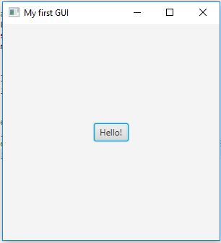
Run the Program
Make sure you saved in Scene Builder!
Otherwise you may not see the GUI.

Slide 29
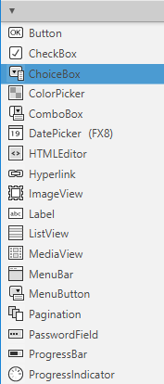
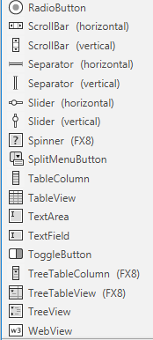
GUI Controls
Popular Controls
Button
Label (plain text)
CheckBox
RadioButton
ToggleGroup
TextField (1 line input)
Password Field
TextArea (many line input)
ComboBox
ListView
ScrollBar
Slider

Slide 30
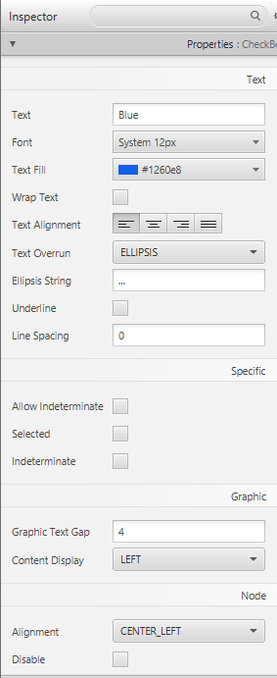
Control Properties
Each control has general properties
Size
Text color
…
And control-specific properties
Checkbox has “selected”

Slide 31
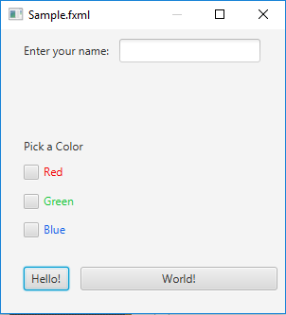
Create a GUI (Group Work)
In the Scene Builder, create a GUI like the one shown:
Include one control OF YOUR CHOICE where the red oval is. Make sure to customize this GUI (text, color, etc…)
Make sure it runs from your main!
CAUTION: Any control that requires options, like a ChoiceBox, ComboBox, or ListView, is NOT going to work right now. They require special code in your .java file.

Slide 32
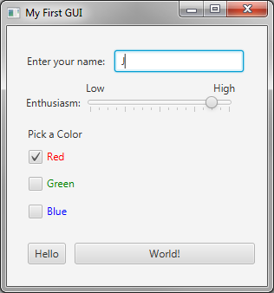
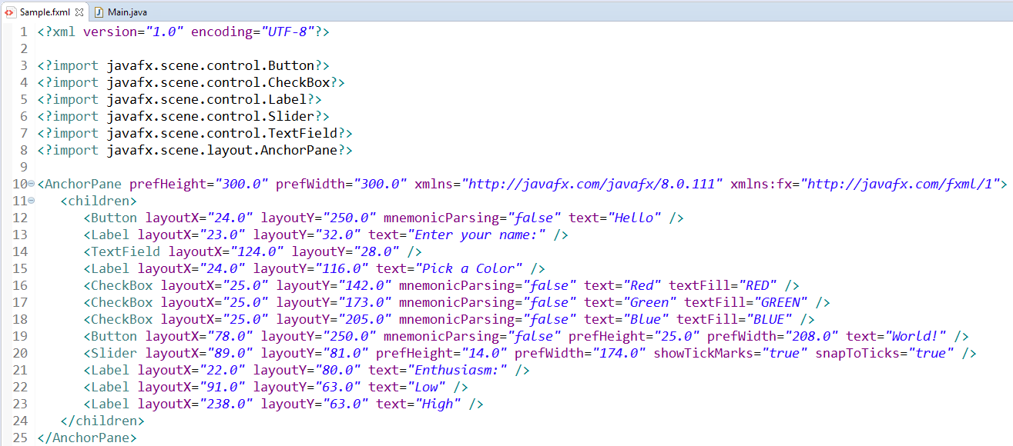
Create a GUI (Solution)
Your group’s code is likely unique!

Slide 33
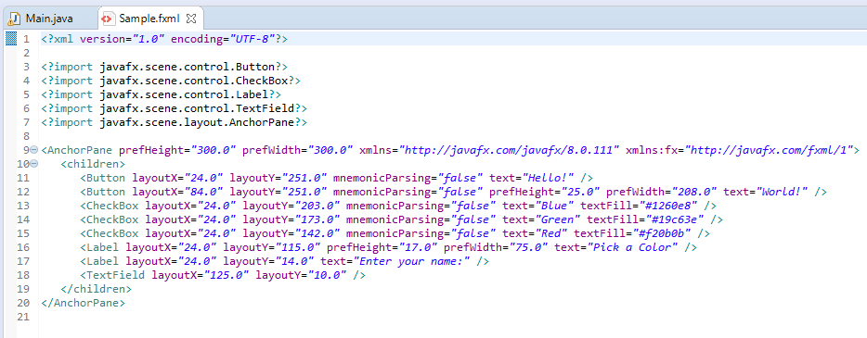
FXML
Remember, you can look at the FXML…
At some point, you may want to edit it by hand if you cannot get the Scene Builder to make it look exactly like you want… so start to explore the FXML.

Slide 34
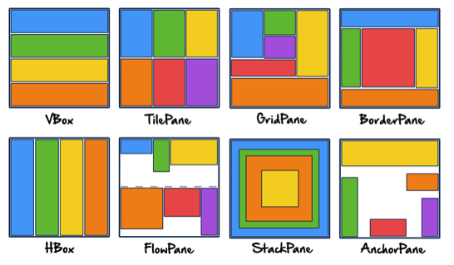
Layouts
Java provides for several default layout styles
We have used AnchorPane, which allows us to specify specific coordinates for each component

Slide 35
Layouts
Mobile Apps use VBox to put one row of information at a time
Windows Apps often use BorderPane… with headers, footers, side panels that are stationary with dynamic and scrolling inner content

Slide 36
Nested Layouts
If you want multiple items in an area of the BorderPane, you must add another layout inside of it
Vbox in the
left panel of
BorderPane

Slide 37
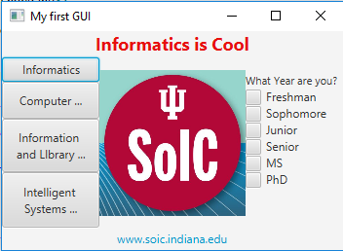
Graphical GUI (Group Work)
Use the BorderPane to create the GUI on the right
You’ll want a nested Vbox on the left and right.
You may use whatever image you like in the center
Create a NEW .fxml document
Make sure you point main to the new .fxml document so it will run the correct code! You’ll also need your .java file to use BorderPane instead of AnchorPane! (Replace all instances)

Slide 38

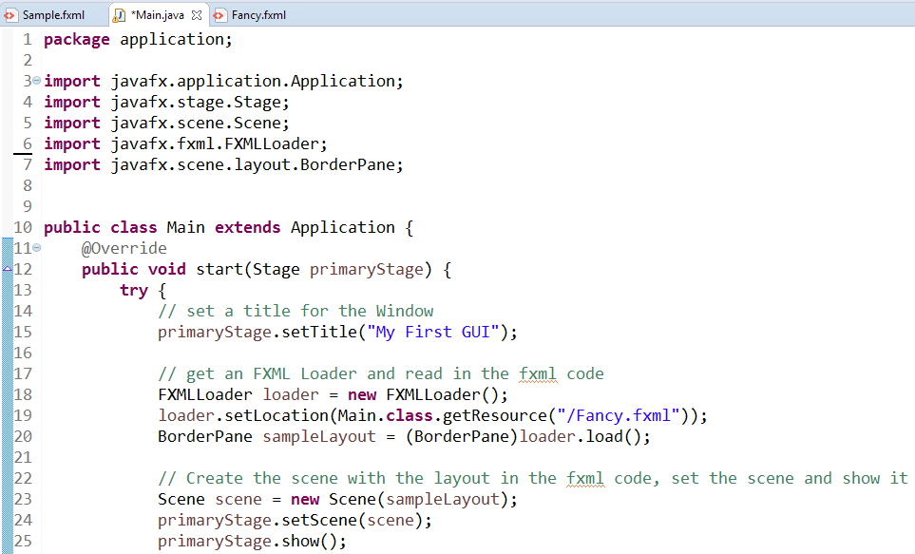
Graphical GUI (Solution pt 1)

Slide 39
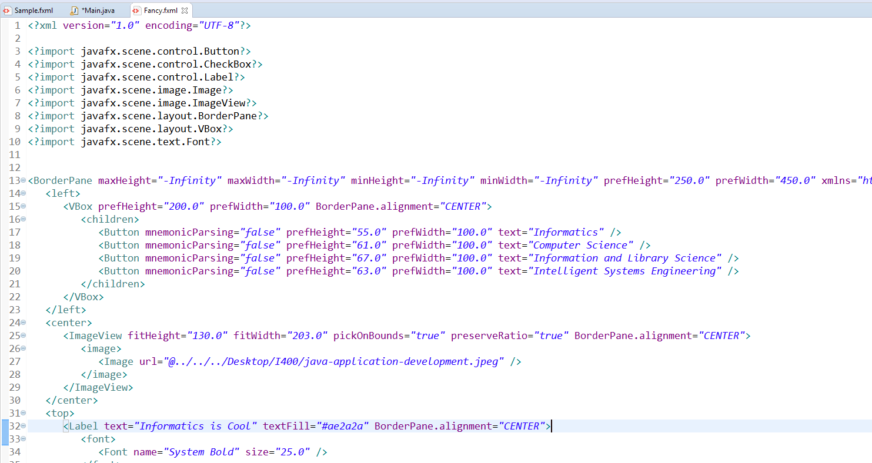
Graphical GUI (Solution pt 2)

Slide 40
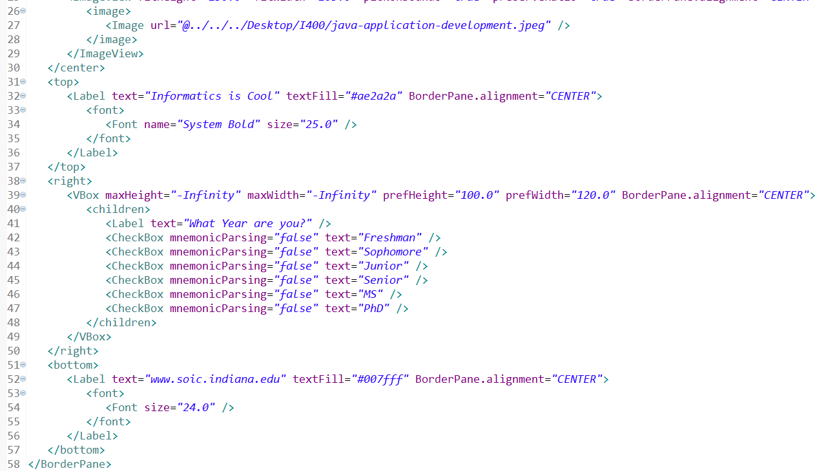
Graphical GUI (Solution pt 3)

Slide 41
Questions?

